Slide 1
Stable Multi-Target Tracking in Real-Time Surveillance Video
Ben Benfold, Ian Reid

Slide 2
Prerequisite: notations

Slide 3
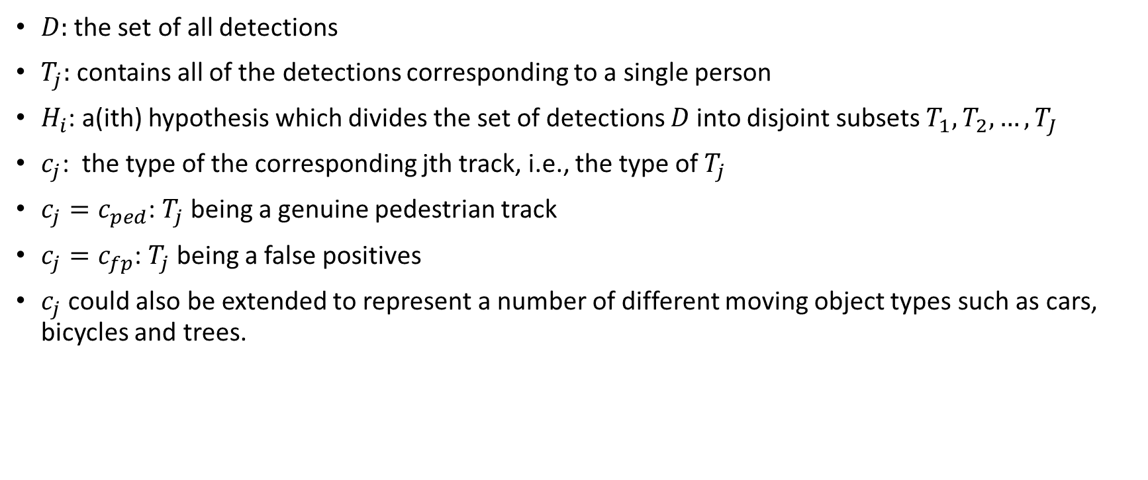
Part of notations
$D$: the set of all detections
$T_{j}$: contains all of the detections corresponding to a single person
$H_{i}$: a(ith) hypothesis which divides the set of detections $D$into disjoint subsets $T_{1}, T_{2}, …, T_{J}$
$c_{j}$: the type of the corresponding jth track, i.e., the type of $T_{j}$
$c_{j}=c_{ped}$: $T_{j}$being a genuine pedestrian track
$c_{j}=c_{fp}$: $T_{j}$being a false positives
$c_{j}$ could also be extended to represent a number of different moving object types such as cars, bicycles and trees.

Slide 4
Model the problem

Slide 5

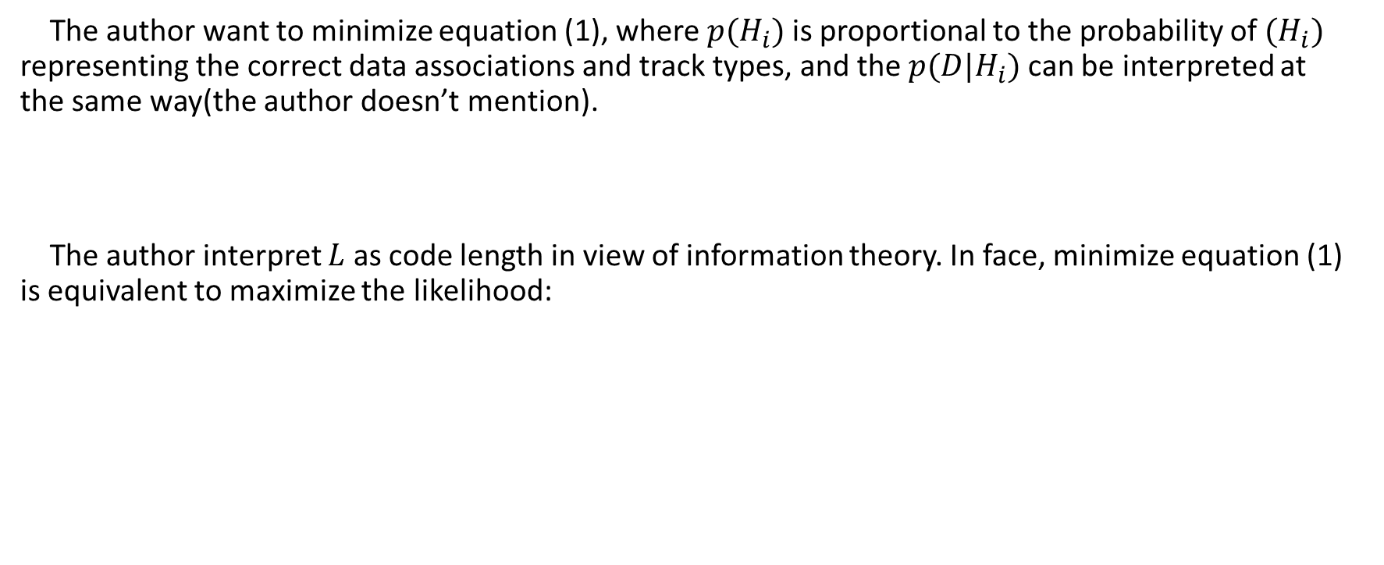
Model by likelihood function
The author want to minimize equation (1), where $p(H_{i})$ is proportional to the probability of $(H_{i})$ representing the correct data associations and track types, and the $p({D|H}_{i})$ can be interpreted at the same way(the author doesn’t mention).
The author interpret $L$ as code length in view of information theory. In face, minimize equation (1) is equivalent to maximize the likelihood:

Slide 6


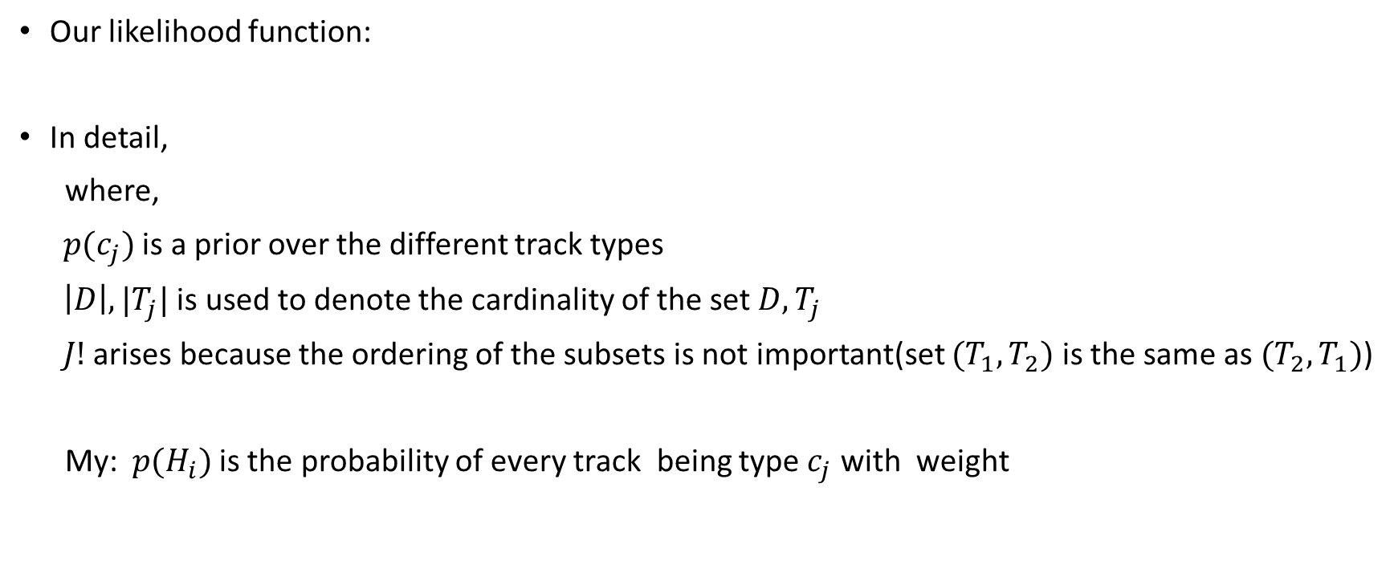
Detail of our likelihood function 1
Our likelihood function:
In detail,
where,
$p(c_{j})$ is a prior over the different track types
$\left|D\right|,|T_{j}|$ is used to denote the cardinality of the set $D, T_{j}$
$J!$ arises because the ordering of the subsets is not important(set ${(T}_{1}, T_{2})$ is the same as $(T_{2}, T_{1})$)
My: $p(H_{i})$ is the probability of every track being type $c_{j}$ with weight

Slide 7
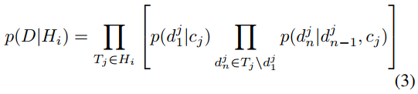


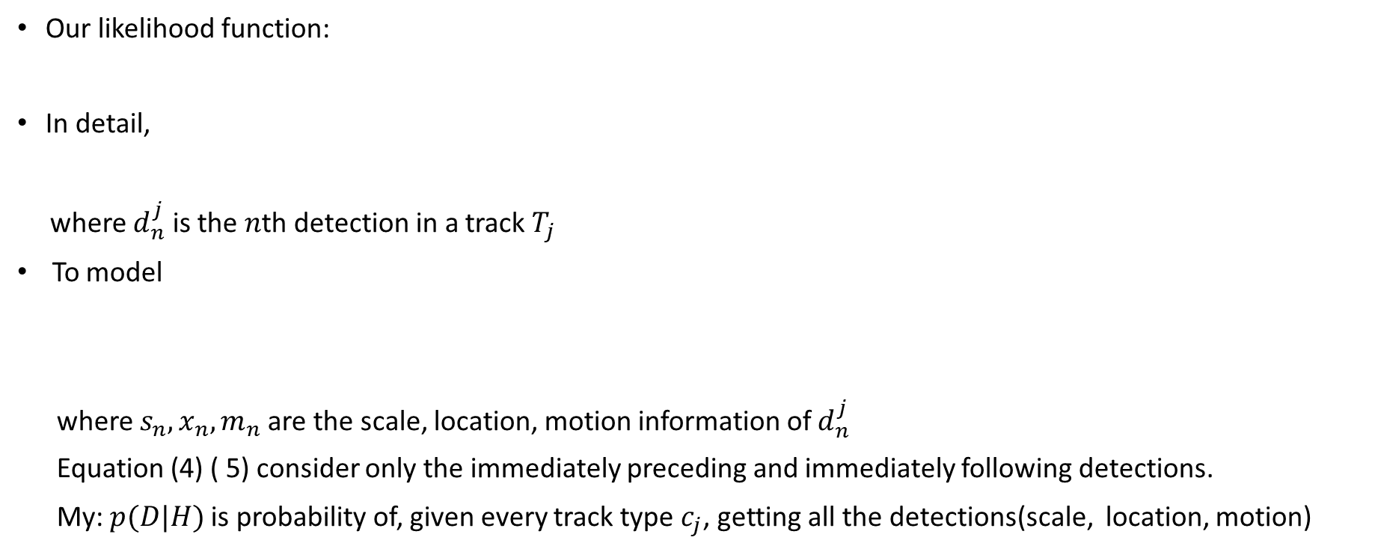
Detail of our likelihood function 2
Our likelihood function:
In detail,
where $d_{n}^{j}$ is the $n$th detection in a track $T_{j}$
To model
where $s_{n}, x_{n}, m_{n}$ are the scale, location, motion information of $d_{n}^{j}$
Equation (4) ( 5) consider only the immediately preceding and immediately following detections.
My: $p(D|H)$ is probability of, given every track type $c_{j}$, getting all the detections(scale, location, motion)

Slide 8

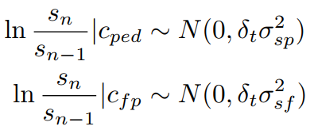

Detail of our likelihood function 3 - scale
Assume
so
where $δ_{t}$ is the time difference between the frames in which the detections were made

Slide 9


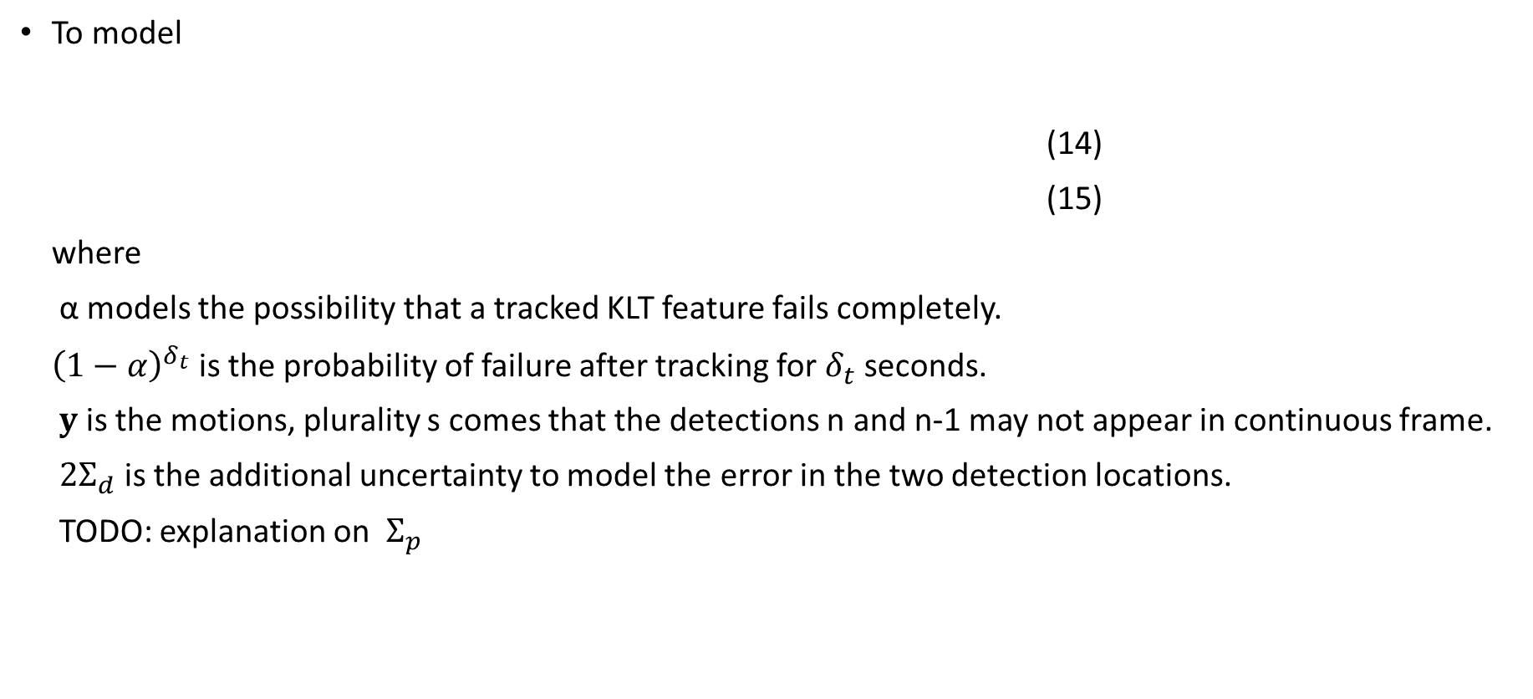
Detail of our likelihood function 4 - location
To model
(14)
(15)
where
α models the possibility that a tracked KLT feature fails completely.
${\left(1−α\right)}^{δ_{t}}$ is the probability of failure after tracking for $δ_{t}$ seconds.
$y$ is the motions, plurality s comes that the detections n and n-1 may not appear in continuous frame.
$2Σ_{d}$ is the additional uncertainty to model the error in the two detection locations.
TODO: explanation on $Σ_{p}$

Slide 10

Detail of our likelihood function 5 - motion
“The last observation considered is the motion magnitude histogram. This is included only to help distinguish between false positives which are expected to have no movement and true positives which are expected to move at least a small amount, so the histogram has just four bins with boundaries representing movement of 1/8, 1/4 and 1/2 pixels per frame. The histograms are expected to conform to one of two multinomial distributions depending on the type of track: ”
I think, because of the proper distinguish between false positives and true positives, we can set the confidence score of detection to a low value, which outputs a very high recall.

Slide 11
Fit & Optimization

Slide 12
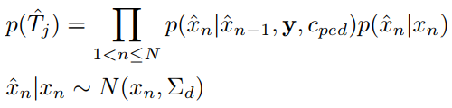

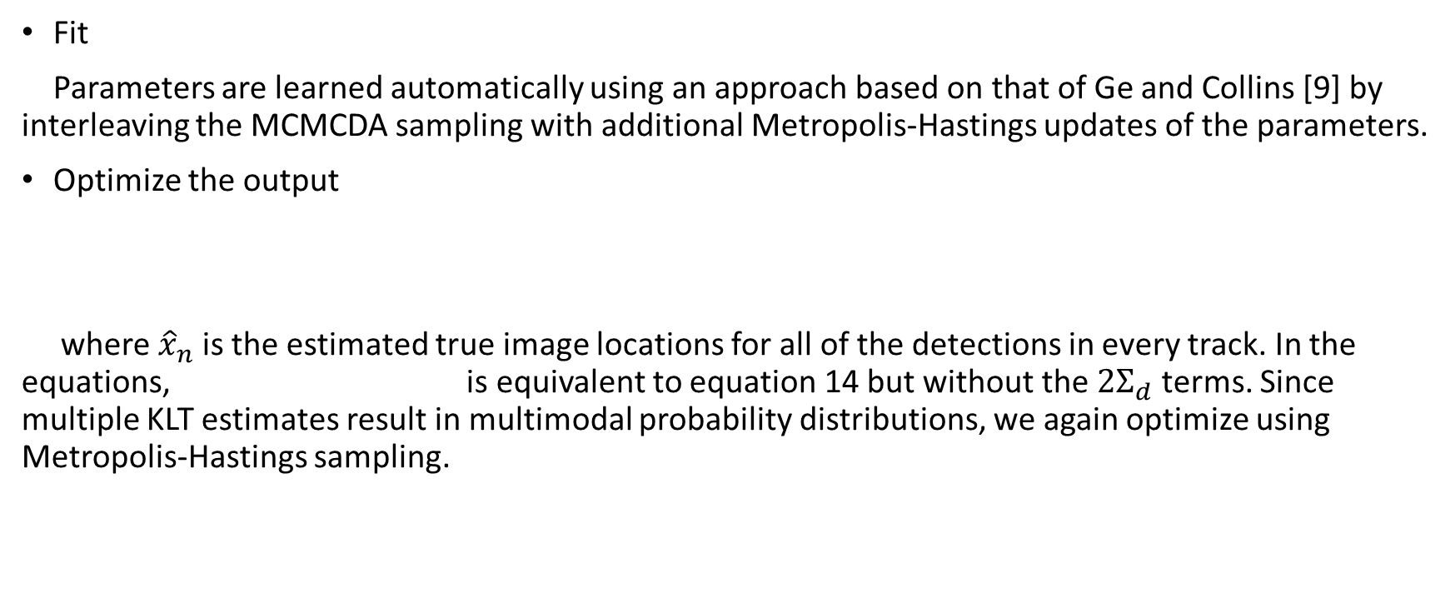
Fit & Optimization
Fit
Parameters are learned automatically using an approach based on that of Ge and Collins [9] by interleaving the MCMCDA sampling with additional Metropolis-Hastings updates of the parameters.
Optimize the output
where ${\hat{x}}_{n}$is the estimated true image locations for all of the detections in every track. In the equations, is equivalent to equation 14 but without the ${2Σ}_{d}$ terms. Since multiple KLT estimates result in multimodal probability distributions, we again optimize using Metropolis-Hastings sampling.

Slide 13
Correction

Slide 14
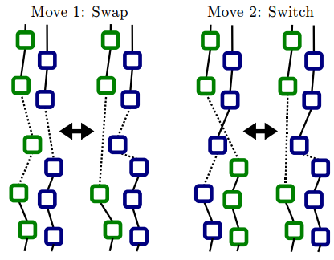
Correct track trajectory 1
There may be some errors in the track, the
author proposes three moving ways to correct.
Move 1. Randomly selecting one detection and one
track, and proposing that the chosen detection be
moved to the chosen track.
Move 2. Choose two tracks and a random time
within the sliding window and propose that all of
the detections occurring after the time in both of
the tracks are swapped with those in the other.
Move 3. Change track type.

Slide 15
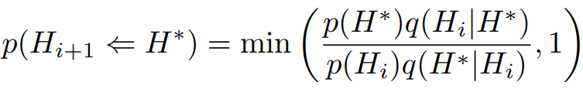
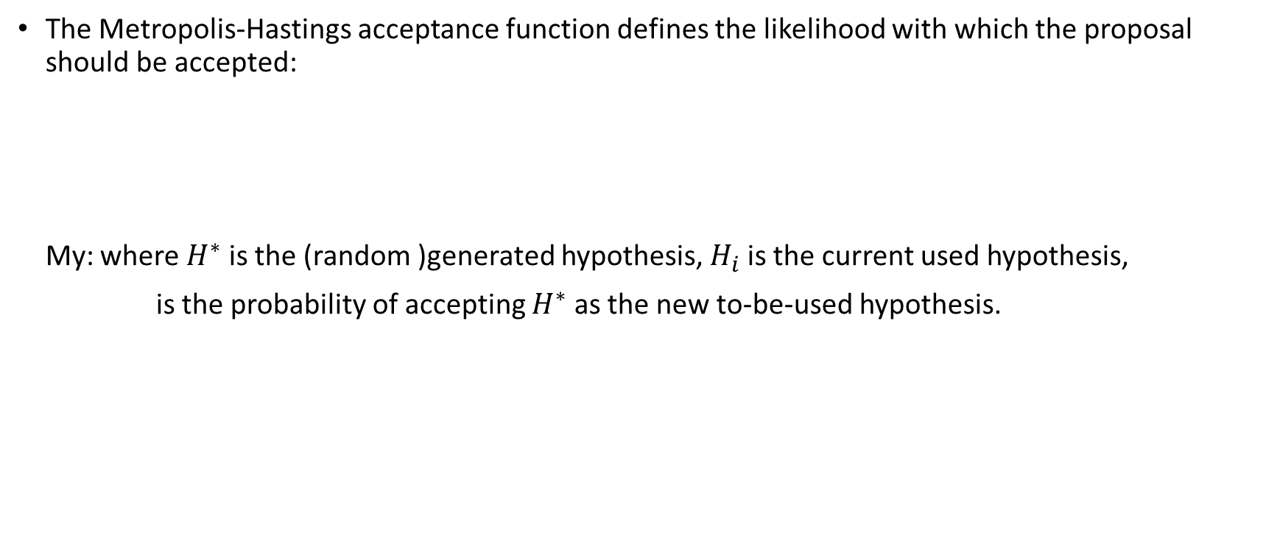
Correct track trajectory 2
The Metropolis-Hastings acceptance function defines the likelihood with which the proposal should be accepted:
My: where $H^{∗}$ is the (random )generated hypothesis, $H_{i}$ is the current used hypothesis,
is the probability of accepting $H^{∗}$ as the new to-be-used hypothesis.

Slide 16
Experiment

Slide 17
Experiment
Data
The dataset is of 1920x1080/25fps and has ground truth consisting of 71500 hand labelled head locations, with an average of sixteen people visible at any time.
Since it uses self-made dataset, numbers are not given here. The dataset is given:
www.robots.ox.ac.uk/ActiveVision/Research/Projects/2009bbenfold_headpose/project.html#datasets
Multi-threads
one for asynchronous detections
one for local feature based tracking (KLT)
one for data association
one for generating and optimising the output
Sample result: www.youtube.com/watch?v=InqV34BcheM&t=4s

